Slide 1

Support vector machine
Dr. Umarani Jayaraman
Assistant Professor

Slide 2
Support Vector Machine (SVM)
Linear classifier
It maximize the margin

Slide 3
Support vector machine

Slide 6
We have infinite number of such linear equation that satisfies the condition

Slide 7
SVM - Intuition
Among all possible decision boundary which one is best suitable to have
That’s where SVM come into picture
Lets illustrate this

Slide 8
SVM
Margin 1: Margin between the line is given

Slide 9
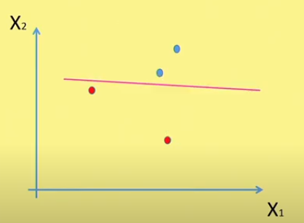
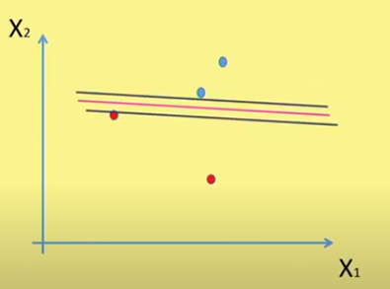
SVM
Margin 2: Margin between the line is given

Slide 10
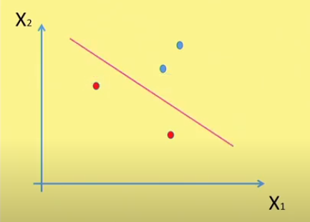
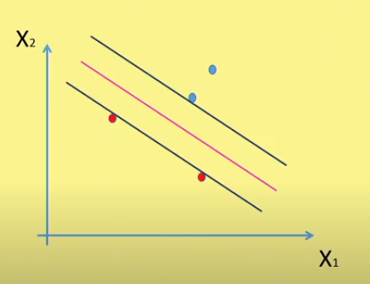
SVM
Margin 3: Margin between the line is given

Slide 11
SVM - Intuition
Among all possible margin, SVM tries to maximize the margin (Margin 3 )

Slide 12
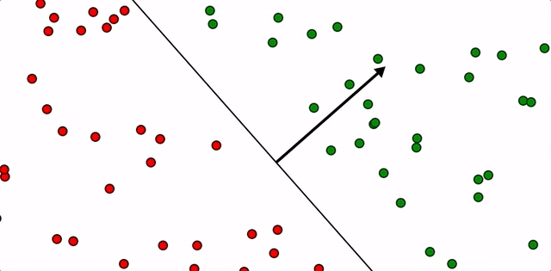
Linear classifier- perceptron

Slide 13
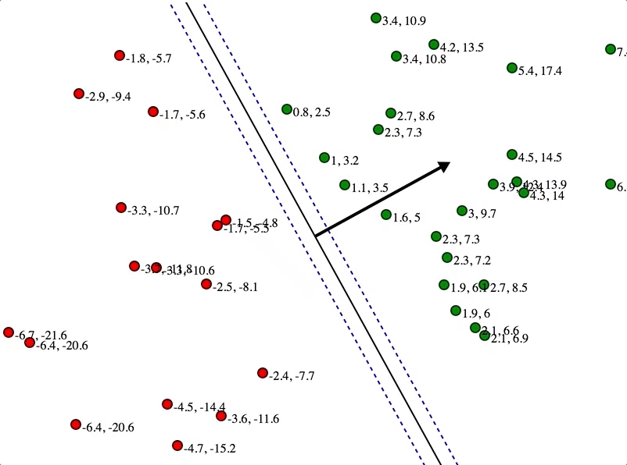
SVM- It tries to maximize the margin

Slide 14
Thank you

Slide 15
Additional slides

Slide 16
Linear Classifier

Slide 17
Linear Classifier

Slide 18
